Slide 1
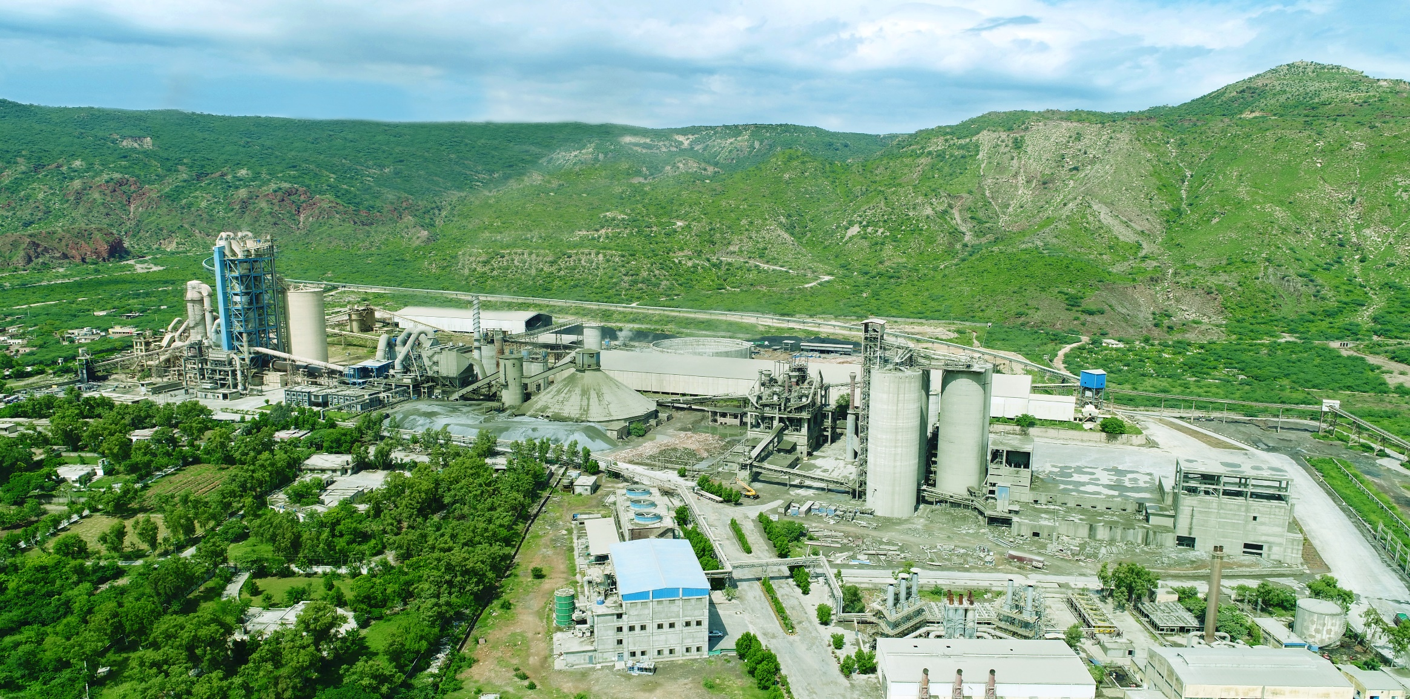
Corporate Briefing 2022
GHARIBWAL CEMENT LIMITED

Slide 2
Introduction about company
GCL was incorporated in 1960.
GCL plant is situated in Tehsil Pind Dadan
Khan, district Chakwal, over more than 347
acres.
Plant has access to GT Road as well as
Motorway and railway line
Company installed capacity is 6,700 TPD (i.e. 2,010,000 ton clinker annually) which is a blend of Chinese & European machinery.
GCL has its own power generation plant of 38.5 MW comprising of 2 HFO, 2 gas based and 3 dual fuel based Wartsila generators.

Slide 3
Introduction about company
Waste Heat Recovery of 20 MW (Including coal based Boiler) alongwith 38.5-MW Captive Power Plant (HFO+Gas) makes total power generation capacity to 58.5 MW approx.
GCL primarily produces and sell “Ordinary Portland Cement (OPC)” under the brand name of "PAIDAR".
Company’s cement was used in various national construction projects such as the Mangla Dam, Qadirabad Barrage, Sulemanki Barrage etc.
GCL has quarry of prime limestone, shale and gypsum (main ingredient of cement) having reserves sufficient for more than100 years
GCL Credit Rating History by PACRA:
Long term A and Short Term A2. Outlook: Stable

Slide 4
ENVIRONMENT COMPLIANCE REVIEW
Company fully comply all rules and regulations of EPA
GCL is located in Zone A (As per EPA/GOP Report) which is positive Zone.
Government of Punjab & Mines and Mineral Department had declared only Zone B & few portion of Zone C as negative whereas all other Zones are positive for expansion & installation of new cement plants

Slide 5
PAKISTAN CEMENT INDUSTRY
Pakistan cement industry operates in two zones; North Zone and South Zone.
North Zone includes provinces of Punjab, Khyber Pakhtunkhwa, Azad Kashmir, Gilgit-Baltistan which represents ~76% of installed capacity in Pakistan. South Zone includes provinces of Sindh & Balochistan representing 24% of the installed capacity..
There are 17 cement manufacturing companies operating with 25-plant locations in the industry.
Both north and south zones have their separate demand-supply dynamics. Players operating in the South Market have the opportunity to tap a number of export markets thus providing greater room for revenue diversification.
Considering stronger local demand in North Zone, reliance on exports is lower. Export potential for players in the North Zone is limited to Afghanistan and India.

Slide 6
GCL Despatch & Capacity Utilization
GCL Despatch in FY 2022 remained 1,683,250 tons
GCL Capacity utilization remained 80% which is in line with the industry average capacity utilization.

Slide 7
Key financial figures-FY 2022

Slide 8
Key financial figures-First Qtr of FY 2023 (September 30)

Slide 9
GCL Net Selling Price/ Retention - Advantage
GCL Retention remained best in industry
GCL Plant is located in center of Punjab
GCL Plant located near to main consumption area
Government is also improving road infrastructure in the area which will further improve company access to areas around plant

Slide 10
Energy Consumption Data – FY 2022

Slide 11
FUTURE DEMAND AND PROSPECTS OF
PAKISTAN CEMENT INDUSTRY
In Pakistan, infrastructure projects and the housing sector are the key drivers for consumption/Demand of cement.
Housing Sector
Increasing urbanization with urban areas having lower number of people per household vis-à-vis rural areas creating additional demand for housing units
Infrastructure
Infrastructure projects are planned to be undertaken under CPEC and PSDP particularly construction of dams/hydro projects, roads, Industrial parks and bridges
Rehabilitation of flood effected areas.

Slide 12
Historic Growth of Local Sales - Last Six (6) Years Average
Industry in north zone had posted a domestic growth of around 7.63% at average over a period of last six years.
From 27.05 million tons in FY 2016 to 39.44 million tons in FY 2022.
On Average 2.1 million tons increase each year

Slide 13
New Production Line upto 10,000 TPD Clinker
Company has signed contract with FLSmidth for Supply of Pyro Process System (CF Silo to Clinker Cooler)
For other machinery company is under discussion with Chines Company
Company has established LC
Partial shipments has arrived at factory
Civil Work is expected to start soon
Project timeline is around 2-years from start of Civil Work

Slide 14
THANK YOU
QUESTIONS & ANSWERS

